Slide 1

Real-time Object Detection for Autonomous Driving using Deep Learning
Duy Anh Tran, Pascal Fischer, Alen Smajic, Yujin So

Slide 2



Problem Framing
01
Initial Solution
02
Preliminary Result
03
Project Schedule
04
Real-time Object Detection for Autonomous Driving
Using current state-of-the-art Algorithms: YOLO and faster-RCNN
What do we expect based on the current experiments and knowledge
Task Assignments and Milestone Plan

Slide 3

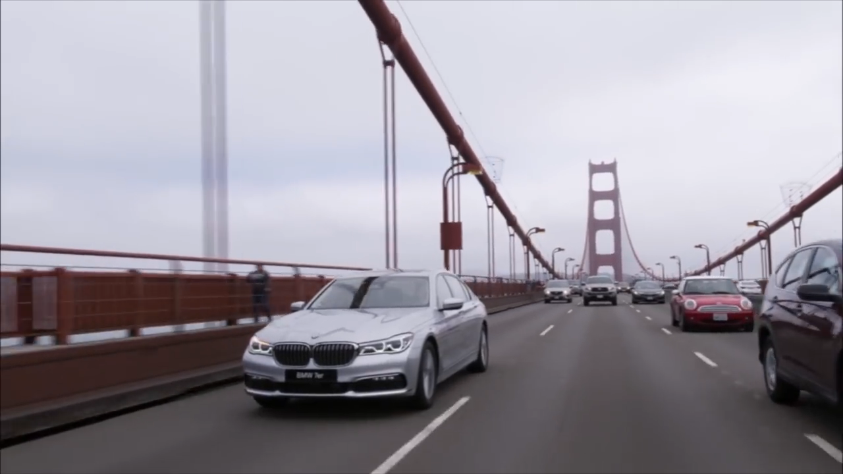
OUR MOTIVATION
Autonomous driving, one of the most anticipated technologies of the 21st century
Major Challenges for Computer Vision and Machine Learning
Huge amount of different situations and different tasks to be solved
One of the most active research topics at the moment

Slide 4
WHAT DO WE DO?
The context consists of road traffic, road users, road signs and other traffic objects
Using State-of-the-art real-time Algorithms like YOLO and faster RCNN
Detect and classify road traffic objects using deep learning
Solving a major task in the long term goal of autonomous driving

Slide 5
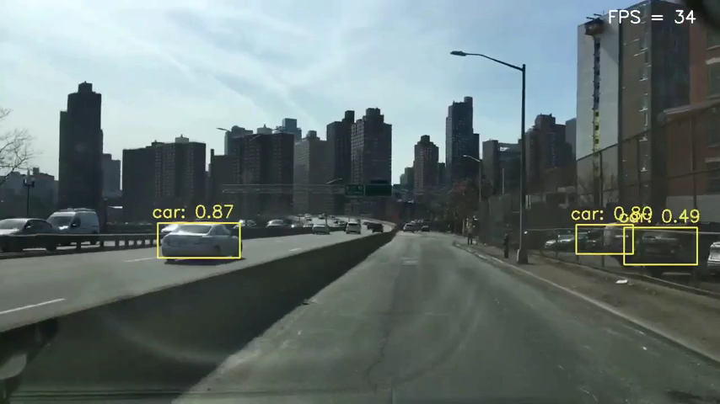
OUR GOAL
Real-time object detection of different object categories in a video
MAP: above 45.7 on BDD100k Dataset

Slide 6
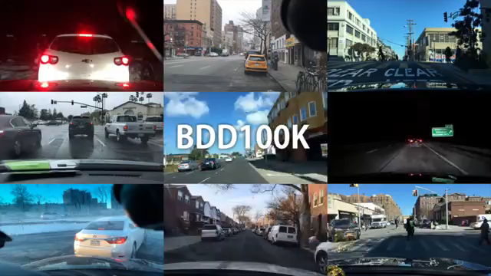
The BDD100K Dataset
100,000 HD video sequences of over 1,100-hour driving experience
2D Bounding Boxes annotated on 100,000 images
13 different object classes
geographic, environmental, and weather diversity
State-of-the-art: hybrid incremental net (MAP: 45.7, threshold: 0.5)

Slide 7
State Of The Art Real-Time Object Detection
COCO Dataset
PASCAL VOC 2007
YOLO
MAP: 63.4
FPS: 46
YOLOv4-P7 (CSP-P7, multi-scale)
MAP: 55.4
FPS: 16
BlitzNet512
(s4)
MAP: 79.1
FPS: 24
EfficientDet-D7x (single-scale)
MAP: 55.1
FPS: 6.5
BlitzNet512
(s8)
MAP: 81.5
FPS: 19.5
NAS-FPN AmoebaNet
(7 @ 384)
MAP: 48.3
FPS: 3.6
R-FCN
MAP: 80.5
FPS: 9
YOLOv4-CSP CD53s 640
MAP: 47.5
FPS: 73
Faster R-CNN
MAP: 73.2
FPS: 7

Slide 8
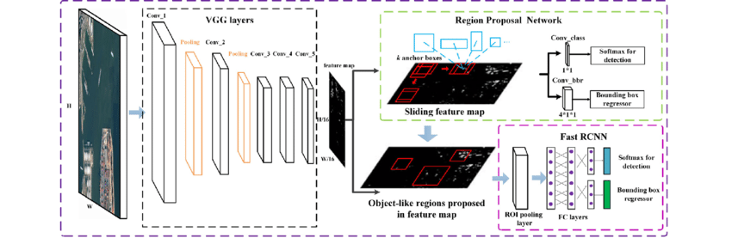
Faster RCNN

Slide 9
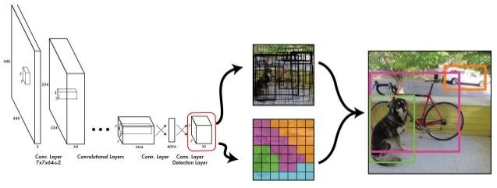
YOLO

Slide 10
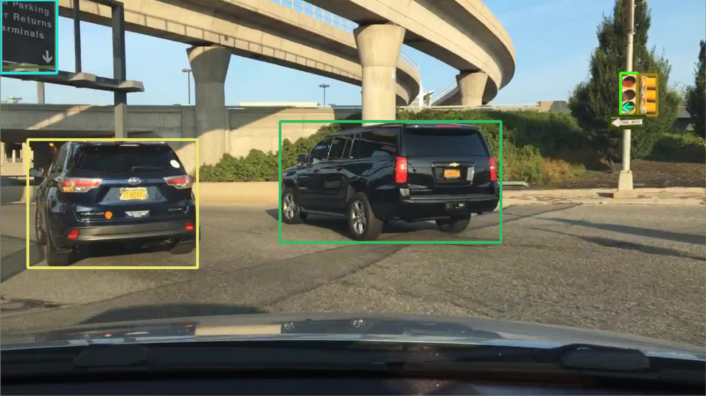
Preliminary Results
Search for a suitable dataset and inspect the content
Data preprocessing from JSON-files
Algorithm for creating bounding boxes
Load data into Tensors

Slide 11
PROJECT SCHEDULE
Week 4-5
Week 1
Week 8
Data Preprocessing faster-RCNN
Implement region proposal network (RPN), put it together with backbone network and train it
Validation and Finetuning
Project Kickoff
Implement faster-RCNN
8. December 2020
Implement Backbone network and pretrain it
Week 6-7
Week 2-3
Result comparison and evaluation
Week 9-10
Final Presentation
Week 10
16. and 18. February 2021
Data Preprocessing YOLO
Implement YOLO
Validation and Finetuning
Start writing report
Week 2-5
Week 7-10
Week 1
Week 6

Slide 12
THANKS!
Do you have any questions?
Duy Anh Tran
Pascal Fischer
Alen Smajic
Yujin So

